Slide 1
A core Course on Modeling
Introduction to Modeling
0LAB0 0LBB0 0LCB0 0LDB0
c.w.a.m.v.overveld@tue.nl
v.a.j.borghuis@tue.nl
S.4

Slide 2
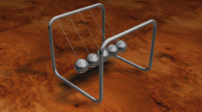
continuous / discrete
2
http://commons.wikimedia.org/wiki/File:Newtons_cradle.gif
Notes:
2
In the badminton game, the shuttle’s motion in between two strokes is a continuous system, governed by forces of gravity and air drag.
Every stroke, however, is a discrete event that can be counted.
continuous:
Measuring rather than counting
Quantities have full range of values (no holes, no jumps: real numbers)
Limits, functions & calculus (d/dt, d/dx, ∫dx, …)
Examples: smooth mechanical & chemical processes, fields, waves, circuits, averages, …
Typical for lectures Dynamical Systems
discrete:
Counting rather than measuring
Quantities have countably many values: integers
Enumeration, graphs & algorithms (t:=t+1, ∑, …)
Examples: jumpy or singular mechanical & chemical processes, particles, business processes, …
Typical for lectures Process Modeling
sampling turns continuous behaviour into a series of discrete ones

Slide 3
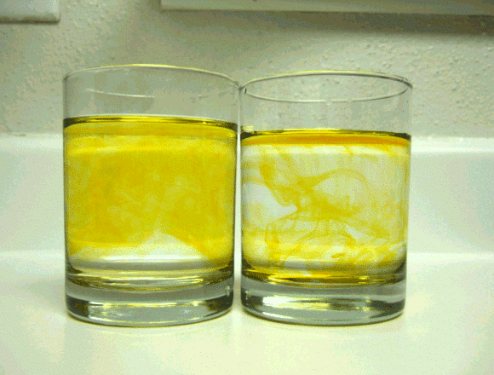
deterministic / stochastic
3
http://commons.wikimedia.org/wiki/File:Dispersion.gif
Notes:
3
The domino game occurred both in a deterministic and a stochastic version. Setting up dominoes in order to have them topple over one by one, every falling domino causing the next one to tumble demonstrates a deterministic process. In a game, however, chance governs which player receives which stones.
Many mechanisms contain uncertainty
Uncertainty may stay, even with more accurate measuring
Repetition: ensemble
(e.g., 1000 dice throws)
Observations on ensemble: aggregated quantities
(e.g., averaging)
… if these notions matter → stochastic modeling
Clicking on the words deterministic /stochastic starts youtube demos
Left: dissolving liquid substance in hot water; right in cold water. Despite the randomness of the motion of the liquid, there are emergent regular patterns such as swirls and eddies. Advanced models serve to describe their behavior in statistical terms.
Yoyo: deterministic: its motions; stochastic: the sales figures in dependence on the weather

Slide 4
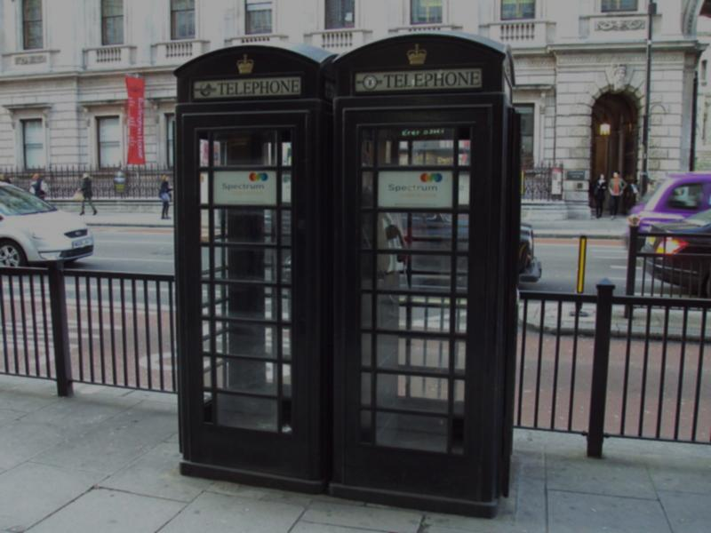
black box / glass box
4
http://commons.wikimedia.org/wiki/File:Black_telephone_boxes,_Piccadilly_-_DSC04253.JPG
Notes:
4
The graph just showing the amount of beer sold over time is a black box model. It has an output (being the graph), but it does not account for the mechanisms that cause this output to result. When we bring in the information about the dates of championships, however, suddenly we can can explain why the graph has two peaks. Then the model turns into a glass box model.
black box:
only known what comes out – perhaps manipulate inputs
model follows from finding patterns in data
techniques: data fitting, extrapolation, data mining
typically empirical research (ID, IE & IS, urban studies, BMT)
glass box:
idea of the inner causality connecting inputs to outputs
model follows by proposing math. representations for causal mechanisms
techniques: postulating functional relations, equations, algorithms
typically simulation (physics, mechanical engineering, BMT)
black →glass: postulate model based on data; fit parameters to data

Slide 5
black box / glass box
Notes:
5
The graph just showing the amount of beer sold over time is a black box model. It has an output (being the graph), but it does not account for the mechanisms that cause this output to result. When we bring in the information about the dates of championships, however, suddenly we can can explain why the graph has two peaks. Then the model turns into a glass box model.
black box:
only known what comes out – perhaps manipulate inputs
model follows from finding patterns in data
techniques: data fitting, extrapolation, data mining
typically empirical research (ID, IE & IS, urban studies, BMT)
glass box:
idea of the inner causality connecting inputs to outputs
model follows by proposing math. representations for causal mechanisms
techniques: postulating functional relations, equations, algorithms
typically simulation (physics, mechanical engineering, BMT)
black →glass: postulate model based on data; fit parameters to data

Slide 6
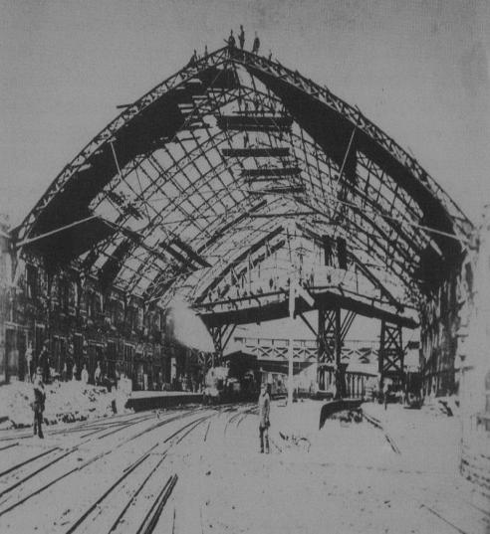
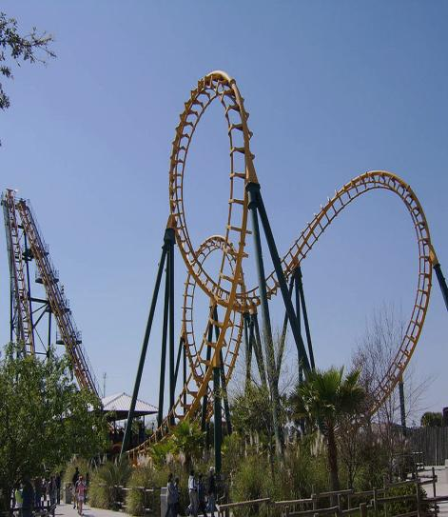
static / dynamic
http://commons.wikimedia.org/wiki/File:BTM_1876_canopy_construction.jpg
http://commons.wikimedia.org/wiki/File:Vekomaboomerang.jpg
Notes:
6
In a house of cards, gravity, friction and normal forces al work together in a delicate balance. Nothing moves. It is a statical system. When playing with cards, however, the state of the game changes with every card being played. It has become a dynamical system. Dynamical systems are represented by dynamical models.
static:
loads (or other quantities) are invariant in time
no causality
d/dt doesn’t matter
dynamic:
loads (or other quantities) vary in time
causality: cause precedes effect
d/dt may matter
a dynamical model typically assumes a statical model first

Slide 7
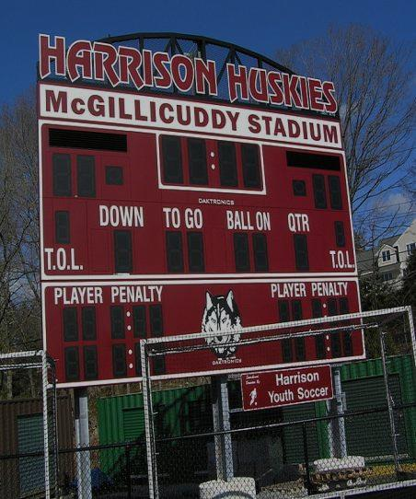
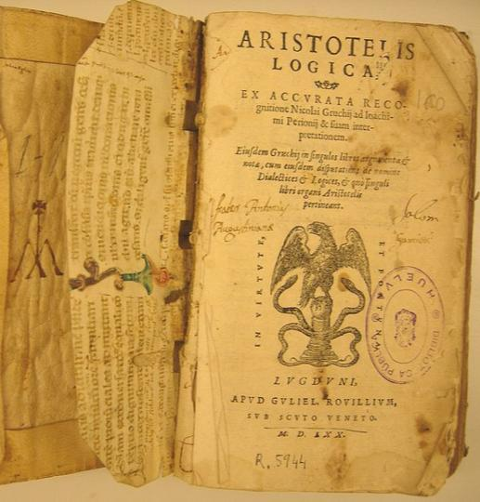
calculating / reasoning
7
http://commons.wikimedia.org/wiki/File:Aristoteles_Logica_1570_Biblioteca_Huelva.jpg
http://commons.wikimedia.org/wiki/File:Scoreboard_at_McGillicuddy_Stadium_2011.JPG
Notes:
7
The score chart shows a number of points for each team. These numbers are the result of calculating. A score chart therefore is a calculational model of a competition. In order to interpret these numbers, for instance to decide if a given team still could become chamion, however, we have to reason.
calculating:
number-valued quantities (numbers): 1,2,3,4,…
operations: +,-,*,/
outcome: numbers
calculating with expressions
applications: physics, chemistry, electrical engineering
reasoning:
truth-valued quantities (propositions): TRUE, FALSE
operations: AND, OR, IMPLIES, …
outcome: the truth or non-truth of a proposition
deriving consequences (e.g., database queries, expert systems)
applications: ICT, business engineering
Some see logic as a model for natural language. Natural reasoning seems to follow certain rules; logic tries to formulate and analyse these rules, and even to propose alternative ones.
logic: connecting and founding both calculating and reasoning
Yoyo: for tricks, one can reason about hand up/down

Slide 8
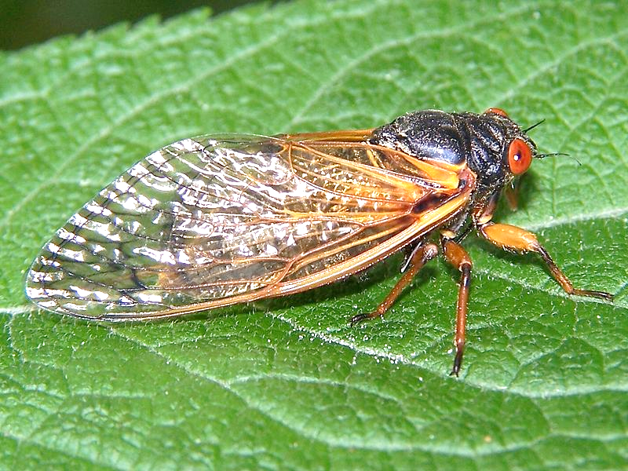
QUIZ
calculating / reasoning
North American Cicada’s spend most of their life underground. They only surface to find a partner to mate.
Two rival species are known to have a 13 and 17 years cycle, respectively.
Why?
8
http://commons.wikimedia.org/wiki/File:Aristoteles_Logica_1570_Biblioteca_Huelva.jpg
http://commons.wikimedia.org/wiki/File:Scoreboard_at_McGillicuddy_Stadium_2011.JPG
Notes:
8
The score chart shows a number of points for each team. These numbers are the result of calculating. A score chart therefore is a calculational model of a competition. In order to interpret these numbers, for instance to decide if a given team still could become chamion, however, we have to reason.
calculating:
number-valued quantities (numbers): 1,2,3,4,…
operations: +,-,*,/
outcome: numbers
calculating with expressions
applications: physics, chemistry, electrical engineering
reasoning:
truth-valued quantities (propositions): TRUE, FALSE
operations: AND, OR, IMPLIES, …
outcome: the truth or non-truth of a proposition
deriving consequences (e.g., database queries, expert systems)
applications: ICT, business engineering
Some see logic as a model for natural language. Natural reasoning seems to follow certain rules; logic tries to formulate and analyse these rules, and even to propose alternative ones.
logic: connecting and founding both calculating and reasoning
Yoyo: for tricks, one can reason about hand up/down

Slide 9
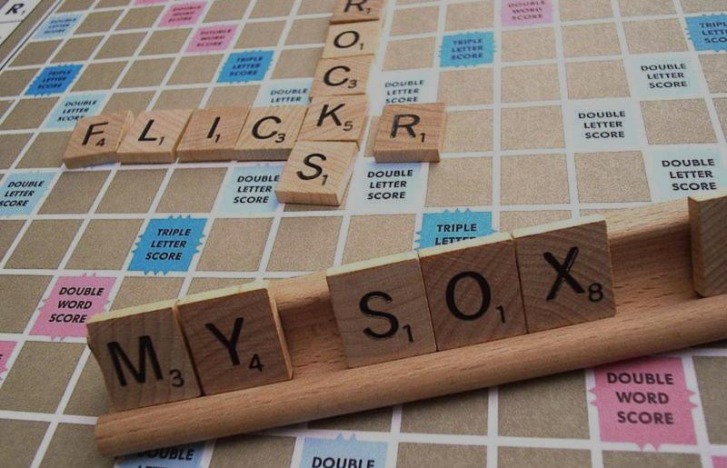
geometric / non-geometric
9
http://commons.wikimedia.org/wiki/File:Flickr_Love.jpg
Notes:
9
The soccer coach, explaining his players where to stand, how to run and in which directions to kick the ball, heavily relies on geometric intuitions. His arguments and strategies involve distances, directions, arcs and symmetry. Systems where these notions are essential are typically represented by geometric models.
intuitions relating to perception of space (Euclid):
location two locations can be close or distant
distance shortest path between two points
straight a straight path
line (segment)
parallell ines that intersect in ∞
direction what parallel lines have in common
angle to measure difference between directions
… if these notions matter → geometric modeling
geometry may mean:
continuous geometry (mechanical engineering, physics)
sampled geometry (civil engineering, BMT, mechanical engineering)
discrete geometry (electronics, urban studies,…)
Yoyo example: calculating the costs is a non-geometric purpose, manufacturing or
describing motions is geometric

Slide 10
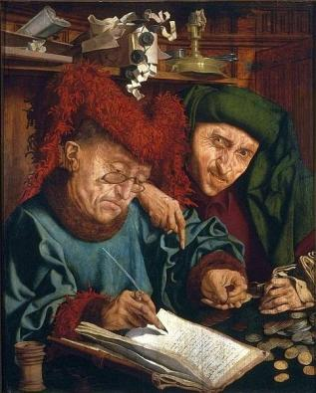
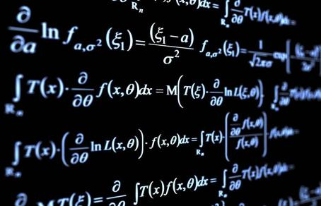
numerical / symbolical
3 x 5 + 3 x 6 = 3 x (5 + 6) = 33
a x b + a x c = a x (b + c) = ?
10
http://commons.wikimedia.org/wiki/File:Reymerswaele_Two_tax_collectors.jpg
http://commons.wikimedia.org/wiki/File:Pure-mathematics-formul%C3%A6-blackboard.jpg
Notes:
10
The price of a cup of coffee can be expressed as a number of Euro’s and Euro cents. This is a numerical representation. We may also refer to this amount by means of symbols. In the film the coupon was such a symbol; in mathematics, we use names such as X or PI to symbolically refer to values. Manipulating such symbols is called algebra; symbolic formulas help to represent many numeric expressions in a single go.
numerical:
manipulate numbers: 3*5+6*3=3*(5+6)=33
one expression accounts for 1 single instance
computers can do numbers better than symbols
approximations, inc. round-off errors (may explode)
continuum problems need sampling
symbolic:
manipulate symbols: ab+ca=a(b+c) = ?
one formula represents ∞ numeric expressions but no outcome
people can do symbols better than numbers
exact, but symbolic manipulation is not always possible (Mathematica)
continuum problems: do without sampling
The formula that we found empirically for a=f(r1/r2) can be derived from physics without at any time stating the actual dimensions of a yoyo
eventually, numerical outcomes are typically needed anyway

Slide 11
numerical / symbolical
3 x 5 + 3 x 6 = 3 x (5 + 6) = 33
a x b + a x c = a x (b + c) = ?
11
QUIZ
Calculate (no pen and paper!)
22 x 18 = ...
1 + 2 + 3 + ... +100 = ...
http://commons.wikimedia.org/wiki/File:Reymerswaele_Two_tax_collectors.jpg
http://commons.wikimedia.org/wiki/File:Pure-mathematics-formul%C3%A6-blackboard.jpg
Notes:
11
The price of a cup of coffee can be expressed as a number of Euro’s and Euro cents. This is a numerical representation. We may also refer to this amount by means of symbols. In the film the coupon was such a symbol; in mathematics, we use names such as X or PI to symbolically refer to values. Manipulating such symbols is called algebra; symbolic formulas help to represent many numeric expressions in a single go.
numerical:
manipulate numbers: 3*5+6*3=3*(5+6)=33
one expression accounts for 1 single instance
computers can do numbers better than symbols
approximations, inc. round-off errors (may explode)
continuum problems need sampling
symbolic:
manipulate symbols: ab+ca=a(b+c) = ?
one formula represents ∞ numeric expressions but no outcome
people can do symbols better than numbers
exact, but symbolic manipulation is not always possible (Mathematica)
continuum problems: do without sampling
The formula that we found empirically for a=f(r1/r2) can be derived from physics without at any time stating the actual dimensions of a yoyo
eventually, numerical outcomes are typically needed anyway

Slide 12
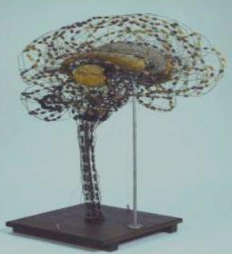
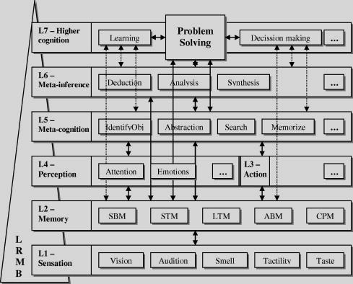
material / immaterial
20th century brain model (Wang & Chiew, UofCalgary, 2010)
19th century brain model, Boerhaave Museum
Notes:
12
In the film, the winner’s cup was an example of a material token of victory; a pat on the shoulder, congratiulations or cheering are immaterial.
A material model can be construct e.g., scale model (wind tunnel, towing tank)
can be natural object (e.g. guinee pig for medical purposes)
material representation is irrelevant (ink+paper, computer screen, …)
a material object requires an immaterial story to become a model
Ask students: what would an example be for yoyos (similar for the next dichotomies)

Slide 13
QUIZ
During a holiday outing on the beach, you took a handful of photographs of an ocean liner, passing at a distance.
You denoted the time for each picture. From these photo’s you would like to estimate when the ship was nearest to you.
Suggest several methods to find out:
geometrically
glass box thinking
black box: reasoning (not calculating)
black box: calculating (numerically)
black box: calculating (symbolically)
Notes:
13

Slide 14
Geometric approach:
assume the ship moves parallel to the beach line
plot the lines of sight on a map
pick the one closest to perpendicular to the beach
http://cdn.morguefile.com/imageData/public/files/j/juanarreo/preview/fldr_2008_11_17/file0001630080819.jpg
Notes:
14

Slide 15
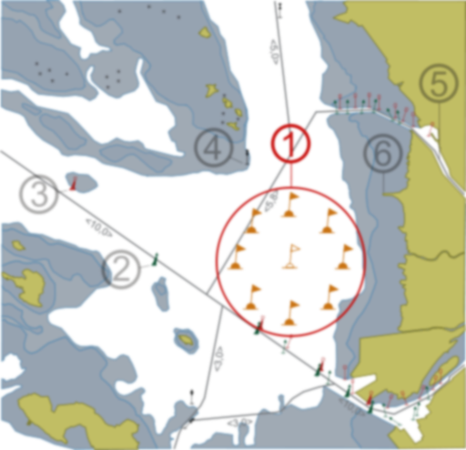
Glass box (use ‘causal’ mechanism):
magnify the photograph that shows the largest image of the ship
read the name of the ship
look up the route information (http://www.sailwx.info/shiptrack/)
find the time of passage closest to you
http://commons.wikimedia.org/wiki/File:Oulunselk%C3%A4_harjoitusrata.svg
Notes:
15

Slide 16
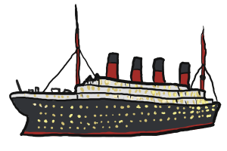
Black box (use data) reasoning:
compare the sizes of the ships in each photograph
time of closest passage occurs somewhere between the two largest images
http://www.clipartlord.com/wp-content/uploads/2013/01/titanic-300x200.png
Notes:
16

Slide 17
Black box (use data) calculating numerically:
measure the sizes of the ships in each photograph
plot in a graph against time
calculate average between two largest values
bad idea if the the two closest pictures are not very similar
y: size of the image of the ship in the photograph
x: time photograph taken
Notes:
17

Slide 18
Black box (use data) calculating symbolically:
measure the sizes of the ships in each photograph
plot in a graph against time
fit a curve of the form y=$\frac{a}{\sqrt{b+c(x−x0)2}}$
where a, b, c and x₀ have to be adjusted to the data
differentiate w.r.t. x and solve for y’(x)=0
this method always gives reliable results
y: size of the image of the ship in the photograph
x: time photograph taken
Notes:
18

Slide 19
Summary of modeling dimensions:
Continuous – Discrete
Deterministic – Stochastic
Black box – Glass box
Static – Dynamic
Calculating – Reasoning
Geometric – Non-geometric
Numerical – Symbolic
Material – Immaterial
Notes:
19

Slide 20
Summary of modeling dimensions:
Continuous – Discrete
Deterministic – Stochastic
Black box – Glass box
Static – Dynamic
Calculating – Reasoning
Geometric – Non-geometric
Numerical – Symbolic
Material – Immaterial
dynamical systems
data modeling
process modeling
modling from scratch
Co Di
Det Sto
Bb Gb
St Dy
Cal Rea
Geo Ng
Nu Sy
M Im
Co Di
Det Sto
Bb Gb
St Dy
Cal Rea
Geo Ng
Nu Sy
M Im
Co Di
Det Sto
GbBb
St Dy
CalRea
GeoNg
NuSy
M Im
Co Di
Det Sto
Bb Gb
St Dy
Cal Rea
Geo Ng
Nu Sy
M Im
20
Notes:
20

